Slide 1
Candidates
Nomination and Campaingning

Slide 2
Restrictions: Candidate vs Voter
 | Age | Fee | Details Provided
Candidate | At least 25 years | Security fee | Pending criminal cases, Assets and liabilities of the candidate, Family details, Educational qualification
Voter | At least 18 years | Free and fair | Aadhar card, Voter ID

Slide 3
Educational Requirements of a Candidate
Education is not necessary for all kinds of jobs. For example, your selection to the school football team is decided by your playing ability, not your marks.
Relevance of education is normally decided by the voters by deciding to whom they should cast their vote.
Many candidates would be ineligible to stand for elections if they do not have a certain degree, such as B.Ed, B.Com, or B.Sc.

Slide 4
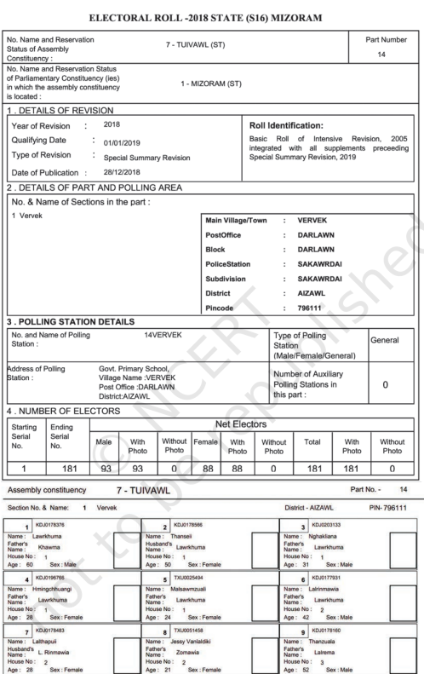
Voter’s List

Slide 5
Campaigning
People should decide their representatives, thus, it is needed to have an open discussion between the candidates and people.
In our country such campaigns take place for a two-week period between the announcement of the final list of candidates and the date of polling.
During this period the candidates contact their voters, political leaders address election meetings and political parties mobilise their supporters.
This is also the period when newspapers and television news are full of election related stories and debates.
But election campaign is not limited to these two weeks only. Political parties start preparing for elections months before they actually take place.

Slide 6
Slogans in Campaigning
Indira Gandhi(INC) - Garibi Hatao (Remove poverty) | Jayaprakash Narayan(JP) - Save Democracy | The Left Front (CPI and others) – Land to the Tiller | N. T. Rama Rao (Desam Party) - Protect the Self-Respect of the Telugus
Motive: To reorient all the policies of the government to remove poverty from the country. | Motive: To undo the excesses committed during Emergency and restore civil liberties. | Motive: To give rights to even tillers in the country, who have low economic status. | Motive: To provide equality with stress on economic and social equality
Year: 1971 | Year: 1977 | Year: 1977 | Year: 1983
General Election | General Election | West Bengal elections | Andhra Pradesh elections

Slide 7
Model Code of Conduct
According to the election law, no party or candidate can:
Bribe or threaten voters;
Appeal to them in the name of caste or religion;
Use government resources for election campaign; and
Spend more than Rs. 25 lakh in a constituency for a Lok Sabha election or Rs. 10 lakh in a constituency in an Assembly election.
Use any place of worship for election propaganda;
Use government vehicles, aircrafts and officials for elections; and
Once elections are announced, Ministers shall not lay foundation stones of any projects, take any big policy decisions or make any promises of providing public facilities.
If they do so, their election can be rejected by the court even after they have been declared elected. In addition to the laws, all the political parties in our country have agreed to a Model Code of Conduct for election campaigns.

Slide 8
Thank You
Keshav Vivek

